Slide 1


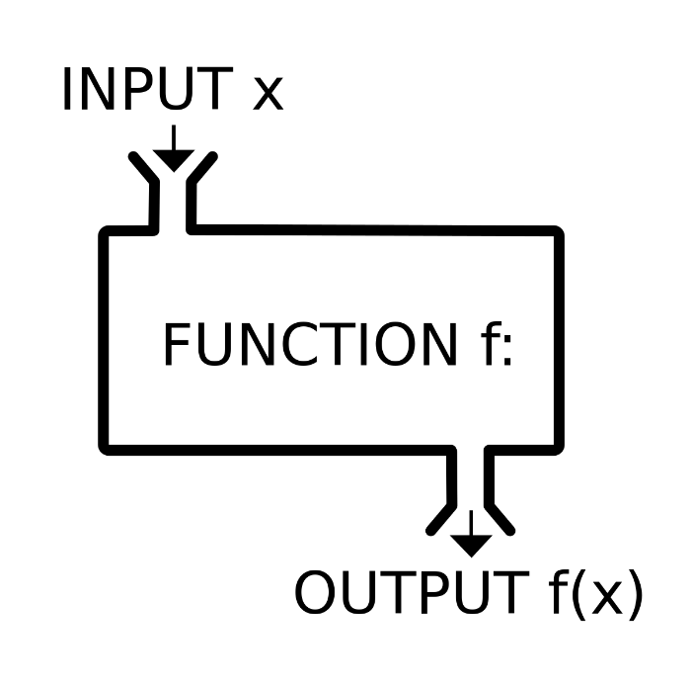


Function, Debugging and Troubleshooting Code
Defining and Using Functions, Overloads, Debugging
Functions
SoftUni Team
Technical Trainers
Software University
http://softuni.bg

Slide 2
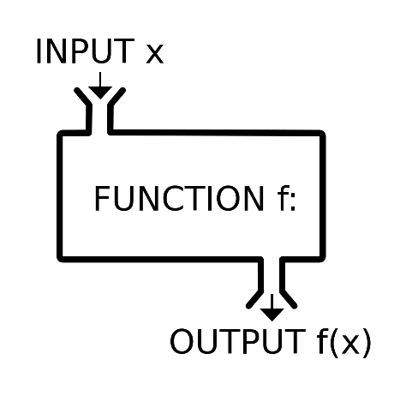

Table of Contents
Using Functions
What is a Function? Why Use Functions?
Declaring and Invoking Function
Functions with Parameters
Passing Parameters and Returning Values
Function Overloading
Debugging and Program Flow
Functions – Naming and Best Practices

Slide 3
Questions?
sli.do #PythonFundamentals

Slide 4
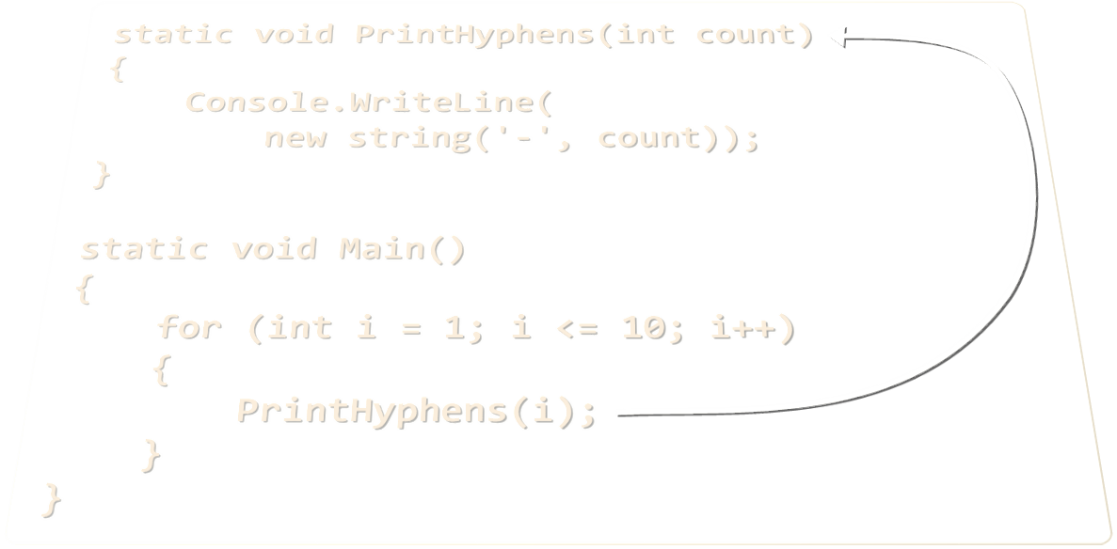
Declaring and Invoking Functions

Slide 5
Simple Functions
Functions are named pieces of code that can be invoked later
Sample function definition:
Invoking (calling) the function several times:
Function named print_header
def print_header():
print("----------")
Function body is always with one indentation more
print_header()
print_header()

Slide 6
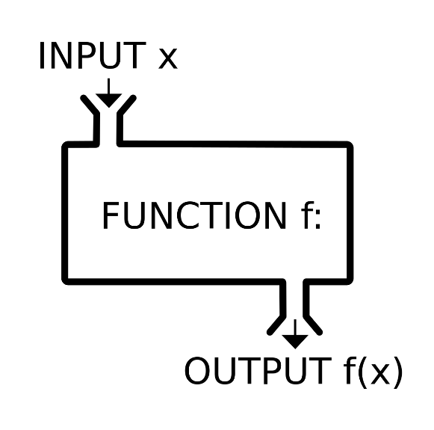

Why Use Functions?
More manageable programming
Splits large problems into small pieces
Better organization of the program
Improves code readability
Improves code understandability
Avoiding repeating code
Improves code maintainability
Code reusability
Using existing Functions several times
Functions

Slide 7
Declaring Functions
Function Name
Parameters
Function Body
def get_product(num1, num2):
return num1 * num2
Variables inside a Function are local
Local Variable
def get_product(num1, num2):
result = num1 * num2
return result

Slide 8
Invoking a Function
Functions are first declared, then invoked (many times)
Functions can be invoked (called) by their name + ():
def print_header():
print("----------")
Function Declaration
Function Invocation
print_header()

Slide 9
Invoking a Function (2)
A Function can be invoked from everywhere in the scope, where it is defined:
Even some other Function
Even in Its own body - recursion
def print_header():
print_header_top()
print_header_bottom()
def crash():
crash()

Slide 10
Problem: Blank Receipt
Create a Function that prints a blank cash receipt:
CASH RECEIPT
------------------------------
Header
Charged to____________________
Received by___________________
Body
------------------------------
© SoftUni
Footer
Check your solution here: https://judge.softuni.bg/Contests/Practice/Index/417#0

Slide 11
Solution: Blank Receipt
Create 3 Functions to print each section (header + body + footer)
Copy the content from the slide
For the copyright sign use the Unicode "\u00A9"
Create a Function print_receipt() that calls these 3 Functions:
Check your solution here: https://judge.softuni.bg/Contests/Practice/Index/417#0

Slide 12
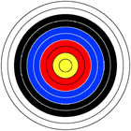
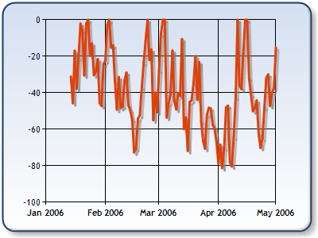
Functions with Parameters
int
long
float
float
decimal

Slide 13
Function Parameters
Function parameters can be of any data type
Call the Function with certain values (arguments)
Accept parameters
start and end
Multiple parameters separated by comma
def print_numbers(start, end):
for i in range(start, end + 1):
print(i, end=' ')
Passing arguments at invocation
print_numbers(5, 10)

Slide 14
Function Parameters (2)
You can pass zero or several parameters
You can pass parameters of different types
Each parameter has name
Multiple parameters of different types
Parameter name
def print_student(name, age, grade):
print("Student: {0}; Age: {1}, Grade: {2}“.format(name, age, grade))

Slide 15
Problem: Sign of Integer Number
Create a Function that prints the sign of an integer number n:
2
The number 2 is positive.
-5
The number -5 is negative.
0
The number 0 is zero.
Check your solution here: https://judge.softuni.bg/Contests/Practice/Index/417#1

Slide 16
Solution: Sign of Integer Number
def print_sign(number):
if number > 0:
print("The number {0} is positive.".format(number))
elif number < 0:
print("The number {0} is negative.".format(number))
else:
print("The number {0} is zero.".format(number))
print_sign(int(input()))
Check your solution here: https://judge.softuni.bg/Contests/Practice/Index/417#1

Slide 17
Optional Parameters
Parameters can accept default values:
The above Function can be called in several ways:
def print_numbers(start = 0, end = 100):
for i in range(start, end + 1):
print(i, end=' ')
Default values
print_numbers(5, 10)
print_numbers(15)
print_numbers()
print_numbers(end=40, start=35)

Slide 18
Problem: Printing Triangle
Create a Function for printing triangles as shown below:
1
1 2
1 2 3
1 2 3 4
1 2 3
1 2
1
1
1 2
1 2 3
1 2
1
3
4
Check your solution here: https://judge.softuni.bg/Contests/Practice/Index/417#2

Slide 19
Solution: Printing Triangle
Create a Function that prints a single line, consisting of numbers from a given start to a given end:
def print_line(start, end):
for i in range(start, end + 1):
print(i, end=' ')
print()
Check your solution here: https://judge.softuni.bg/Contests/Practice/Index/417#2

Slide 20
Solution: Printing Triangle (2)
Create a Function that prints the first half (1..n-1) and then the second half (n…1) of the triangle:
Function with parameter n
def print_triangle(n):
for i in range(1, n):
print_line(1, i)
for i in range(n, 0, -1):
print_line(1, i)
Lines 1...n-1
Lines n…1
Check your solution here: https://judge.softuni.bg/Contests/Practice/Index/417#2

Slide 21
Problem: Draw а Filled Square
Draw at the console a filled square of size n like in the example:
Function with parameter n
--------
-\/\/\/-
-\/\/\/-
--------
def print_header_row(n):
print('-' * 2 * n)
def print_middle_row(n):
print('-', end='')
for i in range(n-1):
print("\\/", end='')
print('-')
4
# TODO: read n
print_header_row(n);
for i in range(n-2):
print_middle_row(n)
print_header_row(n)
Check your solution here: https://judge.softuni.bg/Contests/Practice/Index/417#3

Slide 22

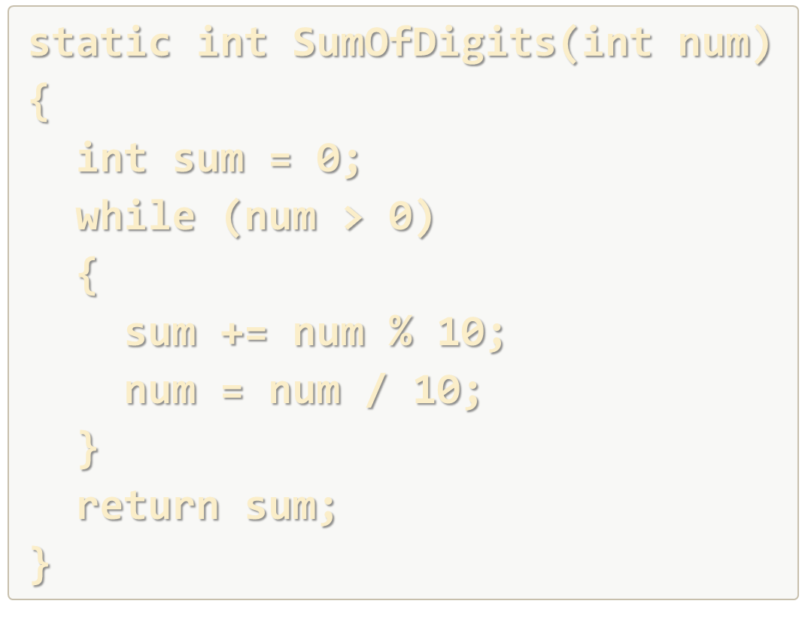
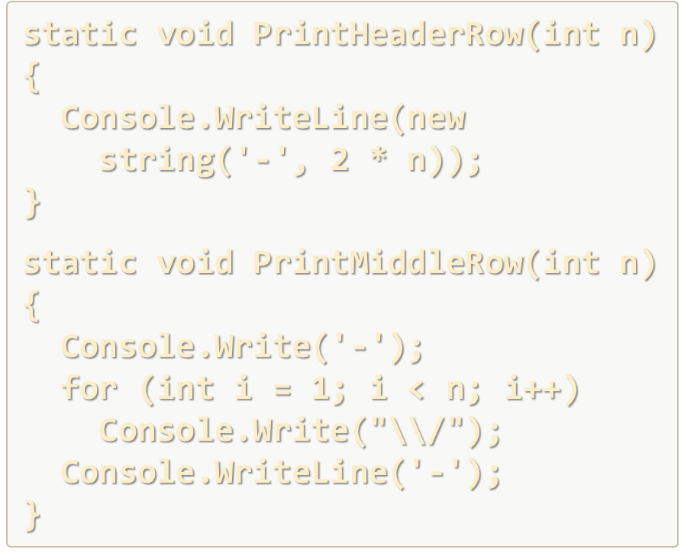
Declaring and Invoking Functions
Live Exercises in Class (Lab)

Slide 23
Returning Values From Functions

Slide 24
The Return Statement
The return keyword immediately stops the Function's execution
Returns the specified value
Functions can be terminated, without returning a value by just using return
def read_full_name():
first_name = input()
last_name = input()
return first_name + " " + last_name
Return a value
def print5():
print(5)
return
print(1)

Slide 25
Using the Return Values
Return value can be:
Assigned to a variable:
Used in expression:
Passed to another Function:
max = get_max(5, 10)
total = get_price() * quantity * 12 / 10
age = int(input())

Slide 26
Temperature Conversion – Example
Convert temperature from Fahrenheit to Celsius:
def fahrenheit_to_celsius(degrees):
celsius = (degrees - 32) * 5 / 9
return celsius
t = float(input("Temperature in Fahrenheit: "))
t = fahrenheit_to_celsius(t)
print("Temperature in Celsius: {0}".format(t))

Slide 27
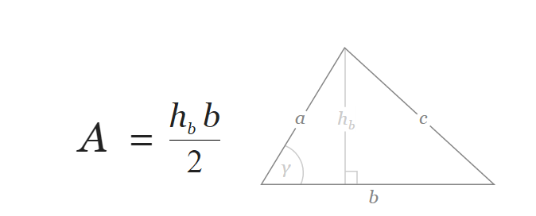
Problem: Calculate Triangle Area
Create a Function that calculates and returns the area of a triangle by given width and height
b = 3
h_{b} = 4
A = 6
Check your solution here: https://judge.softuni.bg/Contests/Practice/Index/417#4

Slide 28
Solution: Calculate Triangle Area
Create a Function with two parameters and a return value:
def calc_triangle_area(side, height):
return side * height / 2
side = float(input())
height = float(input())
print(calc_triangle_area(side, height))
Check your solution here: https://judge.softuni.bg/Contests/Practice/Index/417#4

Slide 29
Problem: Power Function
Create a Function that calculates and returns the value of a number raised to a given power
2⁸
256
3⁴
81
def raise_to_power(number, power):
result = 1;
for i in range(power)
result *= number
return result
Check your solution here: https://judge.softuni.bg/Contests/Practice/Index/417#5

Slide 30

Overloading Functions

Slide 31
Function Signature
The combination of Function's name and parameters is called signature
Signature differentiates between Functions with same names
When Functions with the same name have different signatures, this is called Function "overloading"
Function's signature
def our_print(text):
print(text)

Slide 32
Overloading Functions
Using same name for multiple Functions with different signatures (Function name and parameters)
def our_print(thing1):
print(thing1)
Different Function signatures
def our_print(thing1, thing2):
print(thing1, thing2)

Slide 33
Problem: Greater of Two Values
Create a Function get_max() that returns the greater of two values
int
2
16
16
char
a
z
z
string
aaa
bbb
aaa
Check your solution here: https://judge.softuni.bg/Contests/Practice/Index/417#6

Slide 34
Returning Values and Overloading
Live Exercises in Class (Lab)

Slide 35
Program Execution Flow

Slide 36
Program Execution
The program continues, after a Function execution completes:
def print_logo():
print("Company Logo");
print("http://www.companywebsite.com");
print("before Function executes")
print_logo()
print("after Function executes")
Executes first
Function call
Executes last

Slide 37


Program Execution – Call Stack
"The stack" stores information about the active subroutines (Functions) of a computer program
Keeps track of the point to which each active subroutine should return control when it finishes executing
Call Stack
call
call
Main
Function A
Main
Function A
Function B
START
Function B
return
return

Slide 38
Problem: Multiply Even by Odd Digits
Create a program that multiplies the sum of all even digits of a number by the sum of all odd digits of the same number:
Create a Function called get_multiple_of_evens_and_odds()
Create a Function get_sum_of_even_digits()
Create get_sum_of_odd_digits()
You may need to use abs() for negative numbers
-12345
Evens: 2 4
Odds: 1 3 5
Even sum: 6
Odd sum: 9
54
Check your solution here: https://judge.softuni.bg/Contests/Practice/Index/417#7

Slide 39
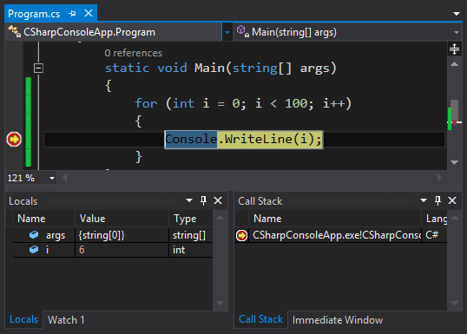

Debugging the Code
Using the PyCharm Debugger

Slide 40

Debugging the Code
The process of debugging application includes:
Spotting an error
Finding the lines of code that cause the error
Fixing the error in the code
Testing to check if the error is gone and no new errors are introduced
Iterative and continuous process
Debuggers helps a lot. Really!

Slide 41
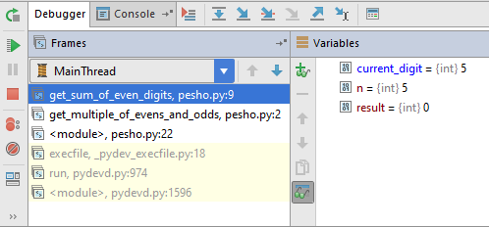
Debugging in PyCharm debugger
PyCharm has a built-in debugger
It provides:
Breakpoints
Ability to trace the code execution
Ability to inspect variables at runtime

Slide 42
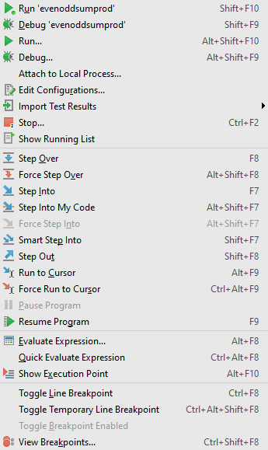
Using the PyCharm
Start without Debugger: [Alt+Shift+F10]
Toggle a breakpoint: [Ctrl+F8]
Start with the Debugger: [Alt+Shift+F9]
Trace the program
Using the Variables

Slide 43

Functions – Naming and Best Practices
Naming
Functions

Slide 44
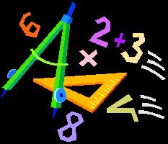


Naming Functions
Functions naming guidelines
Use meaningful Function names
Shol not have capital letters
Function names should answer the question:
What does this Function do?
If you cannot find a good name for a Function, think about whether it has a clear intent
find_student, load_report, sine
findStudent, loadReport,
function1, do_something, handle_stuff, sampleFunction, dirtyHack

Slide 45
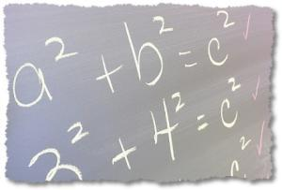
Naming Function Parameters
Function parameters names
Preferred form: [Noun] or [Adjective] + [Noun]
Should no have capital letters (local variables too!)
Should be meaningful
Unit of measure should be obvious
first_name, report, speed, users_list, font_size, font
p, p1, p2, populate, LastName, lastName, convertImage

Slide 46
Functions – Best Practices
Each Function should perform a single, well-defined task
Function's name should describe that task in a clear and non-ambiguous way
Avoid Functions longer than one screen
Split them to several shorter Functions
def print_receipt():
print_header()
printBody()
printFooter()
Self documenting and easy to test
Self documenting and easy to test

Slide 47
Code Structure and Code Formatting
Leave 2 blank lines between Functions
Leave one blank line before and after loops and if statements
Avoid long lines and complex expressions

Slide 48
Debugging and Program Flow
Live Exercises in Class (Lab)

Slide 49

Summary
Break large programs into simple Functions that solve small sub-problems
Functions consist of declaration and body
Functions are invoked by their name + ()
Functions can accept parameters
Parameters take actual values when calling a Function
Functions can return a value or nothing
Debugging helps spotting an error more easily

Slide 50







Functions, Debugging and Troubleshooting
https://softuni.bg/courses/programming-fundamentals

Slide 51

License
This course (slides, examples, demos, videos, homework, etc.) is licensed under the "Creative Commons Attribution-NonCommercial-ShareAlike 4.0 International" license
Attribution: this work may contain portions from
"Fundamentals of Computer Programming with C#" book by Svetlin Nakov & Co. under CC-BY-SA license
Icons from http://www.flaticon.com/ (credits: Freepik, Madebyoliver)

Slide 52





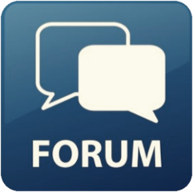
Free Trainings @ Software University
Software University Foundation – softuni.org
Software University – High-Quality Education, Profession and Job for Software Developers
softuni.bg
Software University @ Facebook
facebook.com/SoftwareUniversity
Software University @ YouTube
youtube.com/SoftwareUniversity
Software University Forums – forum.softuni.bg

